Slide 1
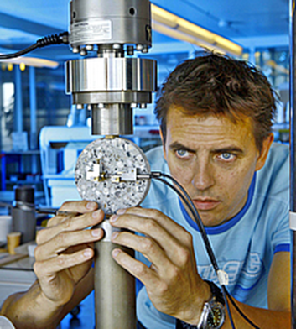
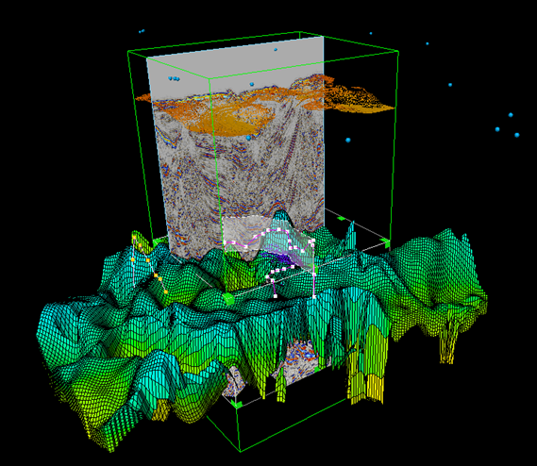
Petrotechnical Data Systems
Transferring geoscientific R&D into innovative software products

Slide 2
PDS
Established in 1993
Oil and Gas market
Scientific Software Products
Two business lines:
CoE (Shell)
proprietary software products for EP companies
120 staff
30 nationalities
Offices in Rijswijk, Houston, Oman and Sofia

Slide 3
PDS / CoE
Established in collaboration with Shell
Founding principles
Scientific software product development capability for Shell Exploration and Production (upstream)
Technology innovation
CoE is a shared collaboration environment
PDS software multidisciplinary product teams
Shell EP P&T R&D teams (research)
Shell EP P&T TACIT (IT Product / Portfolio Management)

Slide 4
Who are we ? Perspectives on PDS
Pluriform: 30 nationalities
Multinational: offices in US, NL, Bulgaria, Oman
Academic disciplines
Applied physics, computer science, geoscience, applied mathematics
Academic level
75% MSc, 25% with Phd
Capabilities:
Software product engineering,
Mathematics
Geosciences
Company Culture:
Knowledge and development oriented, innovative, egalitarian, result orientation, collaborative, openness

Slide 5
PDS / CoE: geoscience software products
Demo Seismic Toolkit

Slide 6
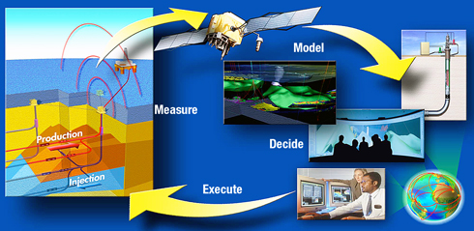
PDS / EP software
Marketing two products for Oil and Gas Industry
Production Enterprise™
CasePoint™

Slide 7
CoE and Applied Mathematics
Pressure prediction software (Computational Fluid Dynamics)
Seismic data processing (2D and 3D image processing)
Simulating reservoir maturisation (Finite Element Methods, Non-linear solvers)
Seismic inversion (FFT, Digital Signal Processing, Quantitative Statistical Analysis)

Slide 8
What do we offer ?
Top learning and development environment through:
In depth workshops
Internships
Master thesis projects
Part time and fulltime jobs
Actual examples:
Internship:
HPC case study in Seismic Processing
Master thesis projects:
HPC applied in Geomechanics
Stratigraphic sequencing of geological structures

Slide 9
Internships / master thesis projects
Sofia: work on the CaseFlow product:
Data Context Expression Engine
Workflow visualization
Workflow validation
Workflow Pattern Implementation
Rijswijk:
mathematical master thesis projects (HPC, scientific computing)

Slide 10
More information
Company:
www.pds.nl
www.productionenterprise.com
Internships/master thesis/jobs:
eric.kreupeling@pds.nl
eric.kreupeling@shell.com

Slide 11
Backup slides

Slide 12
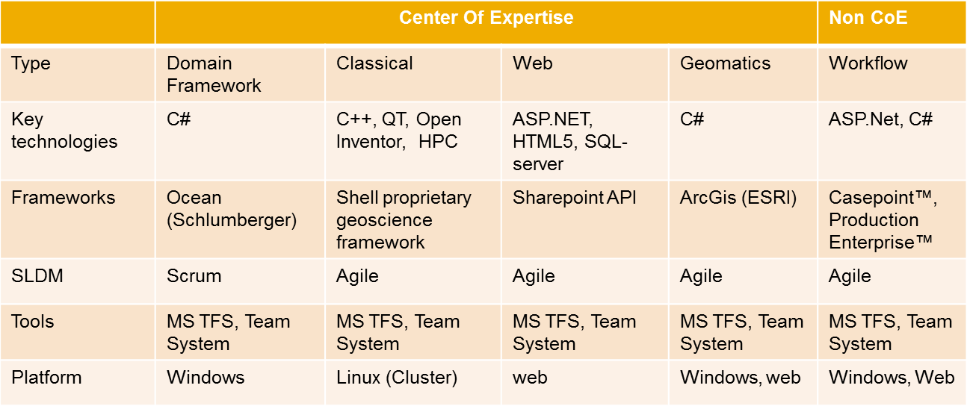
Technology ‘ecosytems’ in CoE

Slide 13
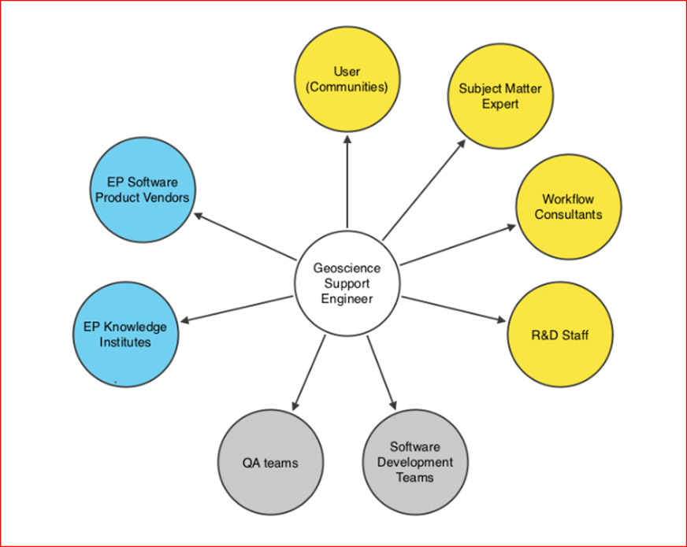
CoE and Geoscientists

Slide 14
What are we looking for ?
Build long term relation based on shared interests and commitment, targeting:
Joint development of academic capabilities (joint master thesis projects, joint Phd’s / Phd funding,)
Identify, attract, develop and on-board students with specific software engineering / mathematical drives/orientations at the earliest appropriate phase

Slide 15
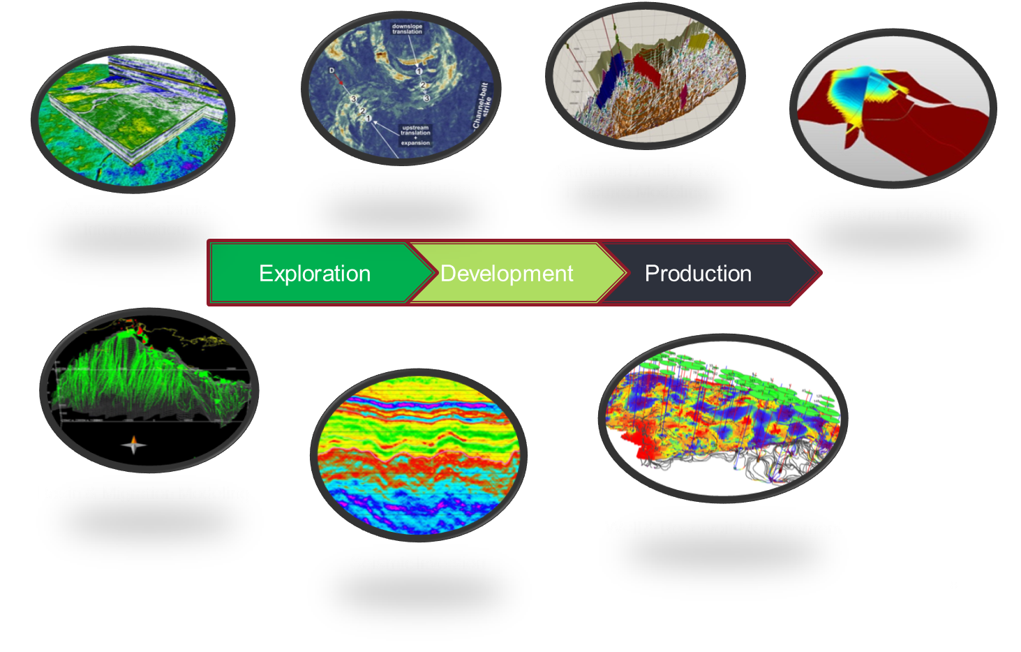
CoE and Geosciences

